Slide 1
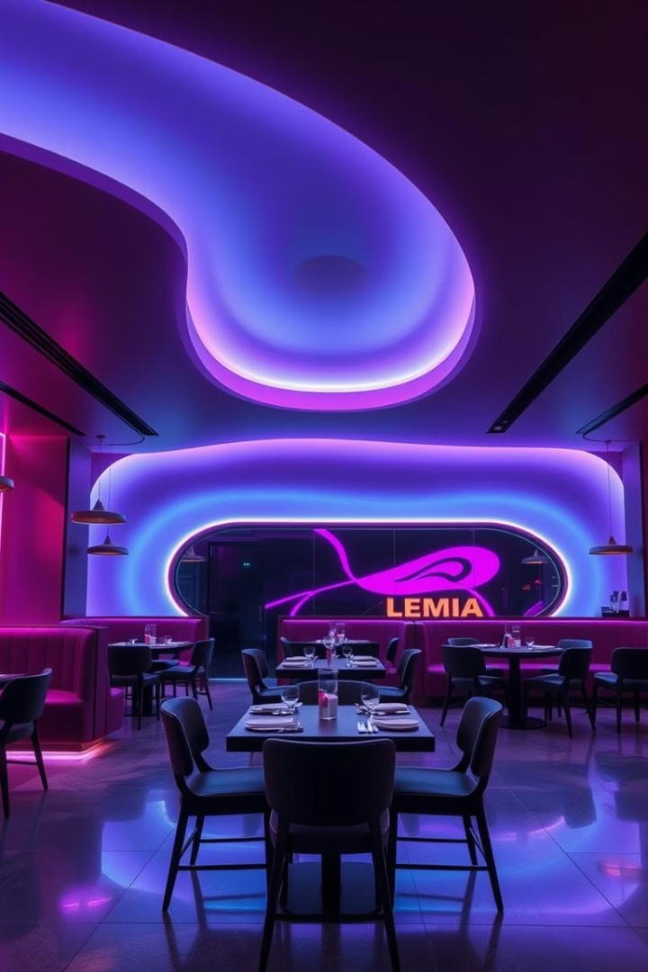
Future Eats: Smart Restaurant Management App using Gen AI
CRS Name: Artificial Intelligence
Name: Prakhar Sharma
Data: 22/04/25
FutureEats optimizes dining workflows, enhances user experiences, and promotes sustainability.

Slide 2
Introduction
FutureEats: A smart platform using Generative AI and ML.
Optimizes dining, enhances user experiences and promotes sustainability.
Automation in restaurants and demand for personalized options inspired this project.

Slide 3
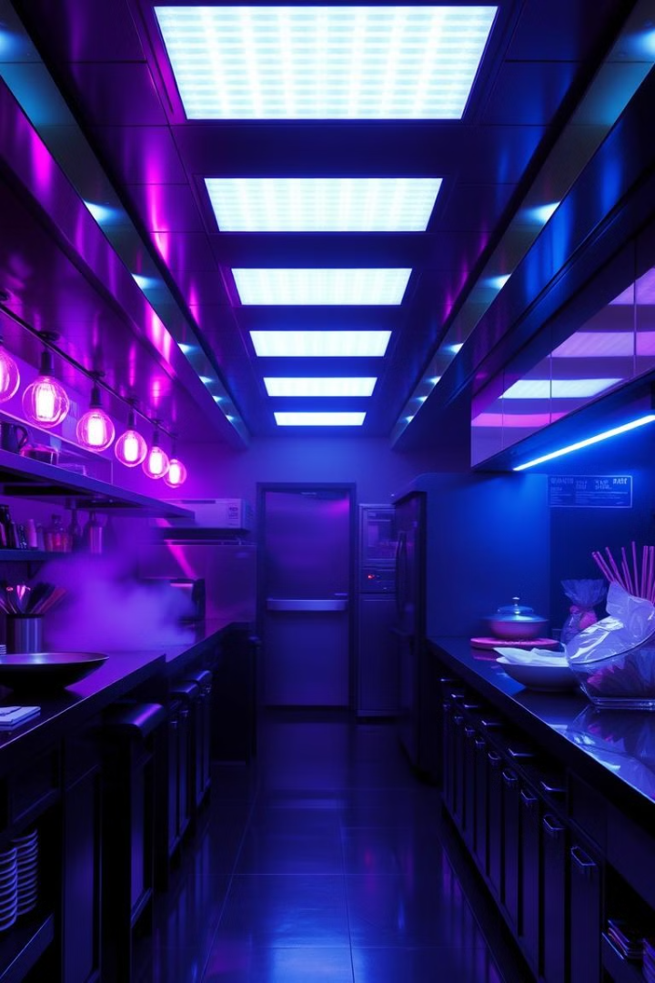
Problem Statement
Long wait times impact customer satisfaction.
Inconsistent service and manual order errors.
Inefficient demand prediction and inventory.
Traditional systems lack smart automation.

Slide 4
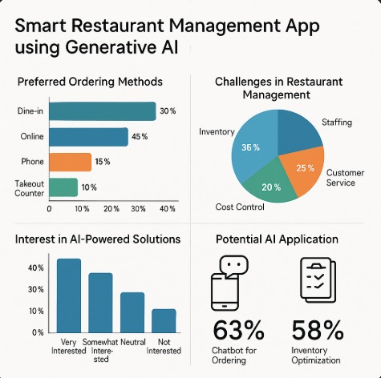
Research and Background
User research: interviews and surveys.
Trends: Personalization, health, and sustainability.
Focus: AI automation and engaging interfaces.

Slide 5

Methodology
Development Process:
Defined core features based on user needs.
Designed UI with Streamlit.
Integrated AI models & multimodal input.
Feedback loop with a 31-day curated menu.

Slide 6
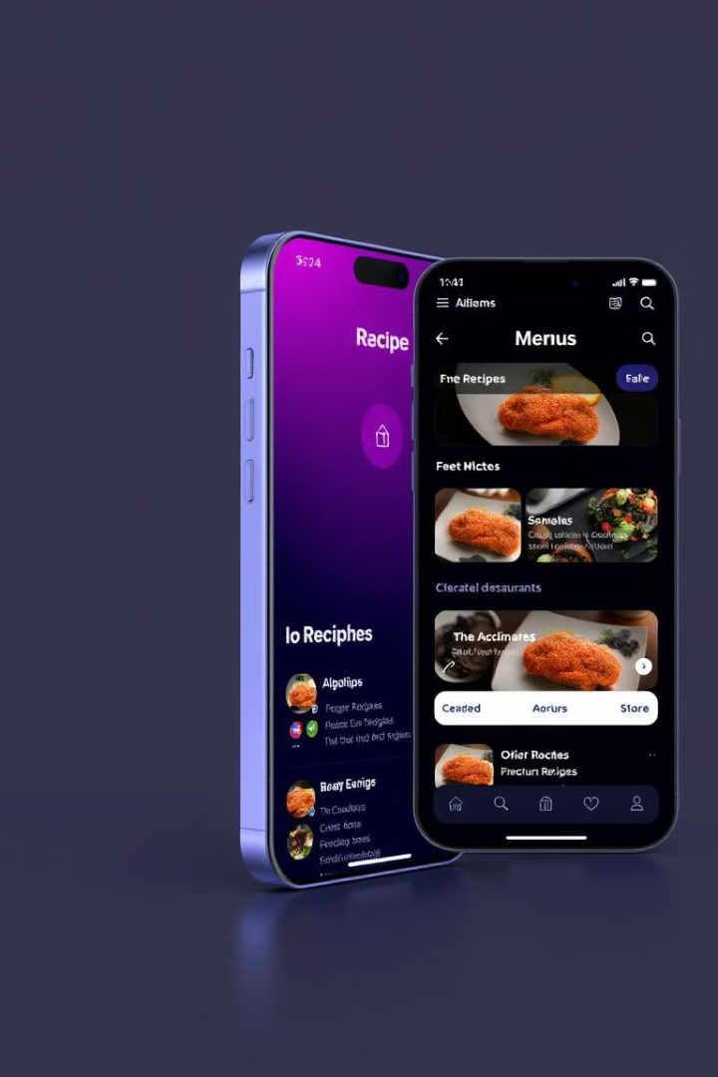
Features and Functionalities
AI Recipe & Menu Generator: Tailored recipes from inputs.
Training Modules: Onboarding for chefs and managers.
Gamification System: Recipe challenges & leaderboards.
Multimodal Input Processing: Text, images, documents.
Leftover Ingredient Management: AI reuse ideas.
Event Planning: AI uses customers preferences for event planning.
https://chefgames-ncxwkz6xxeyzfx7wgzunqy.streamlit.app/
https://idai11000260prakharmanager-train-khsp5pc3z88moxifvh4fmx.streamlit.app/
https://chefgames-jgrne4mt8xfs69yfi87s2u.streamlit.app/
https://cap-test-araangwkcnafde6jifusoc.streamlit.app/
https://github.com/pra123134/IDAI1_1000260_prakhar_capstone_final-120108.git

Slide 7
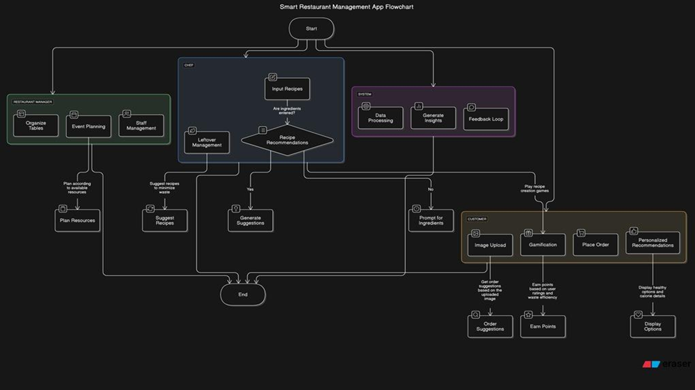

Slide 8
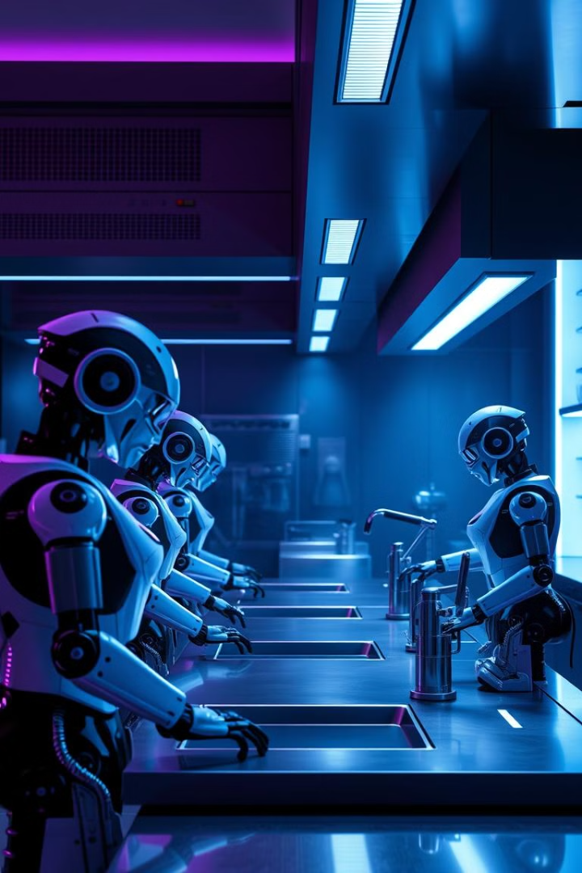
Future Improvements
Advanced Analytics Dashboards: User behavior insights.
Event Planning Assistant: Chatbot-led customization.
ERM(Enterprise Resource Management) System
Pos(Point of Sales)system
Sales & Feedback Analytics
Link with voice assistants like Alexa or Google Home.
Offer multilingual support using AI.
Track health and calories by analyzing dish images.
Collaborate with delivery platforms for smart pricing.
Visual Menu: AI search based on diet or images
Generative Promotions: Smart offers and campaigns.
Inventory Optimization: Predictive alerts.

Slide 9
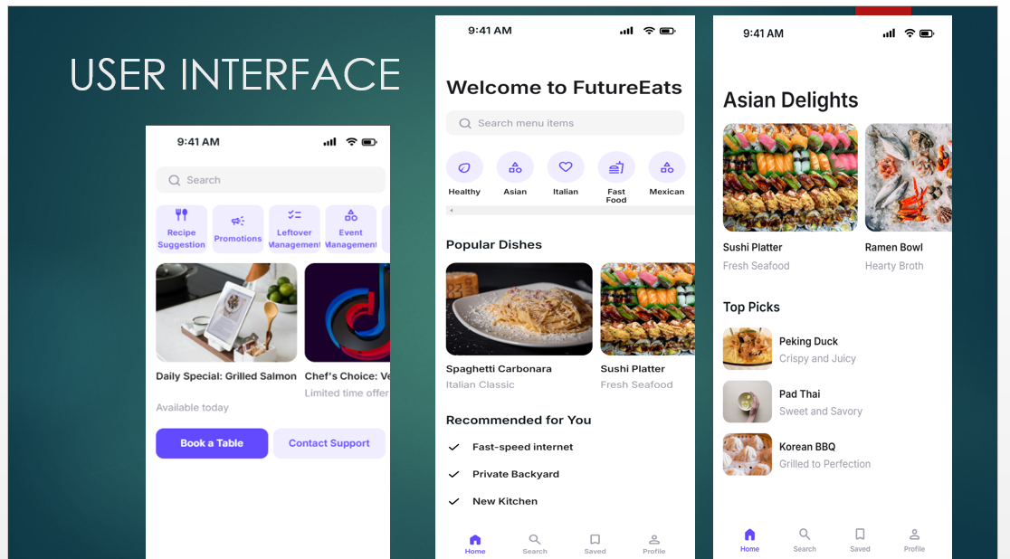
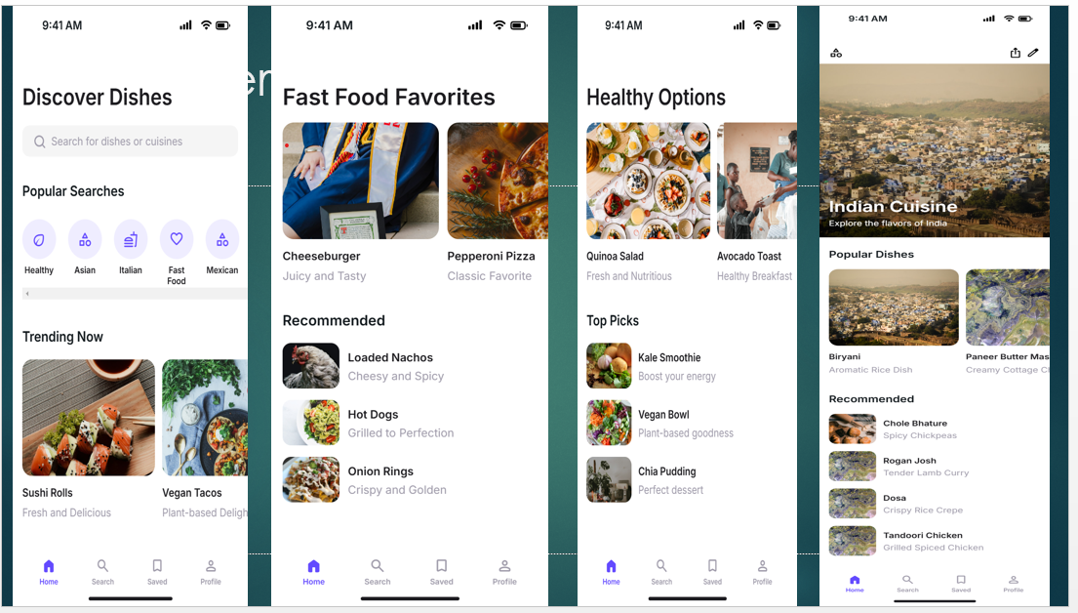
eUI for wireframes

Slide 10
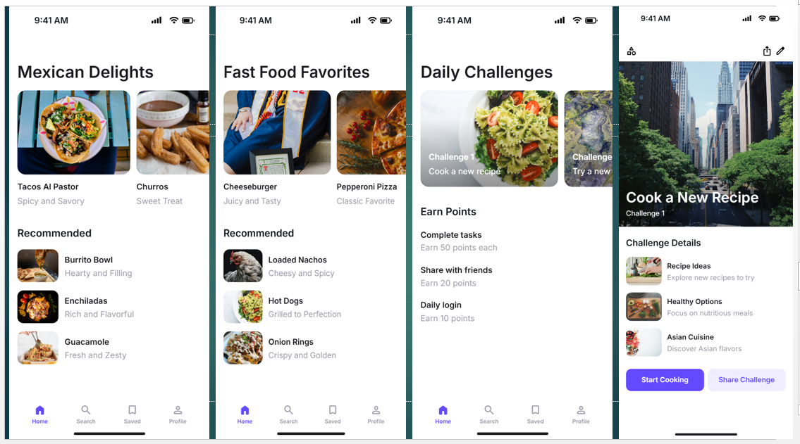
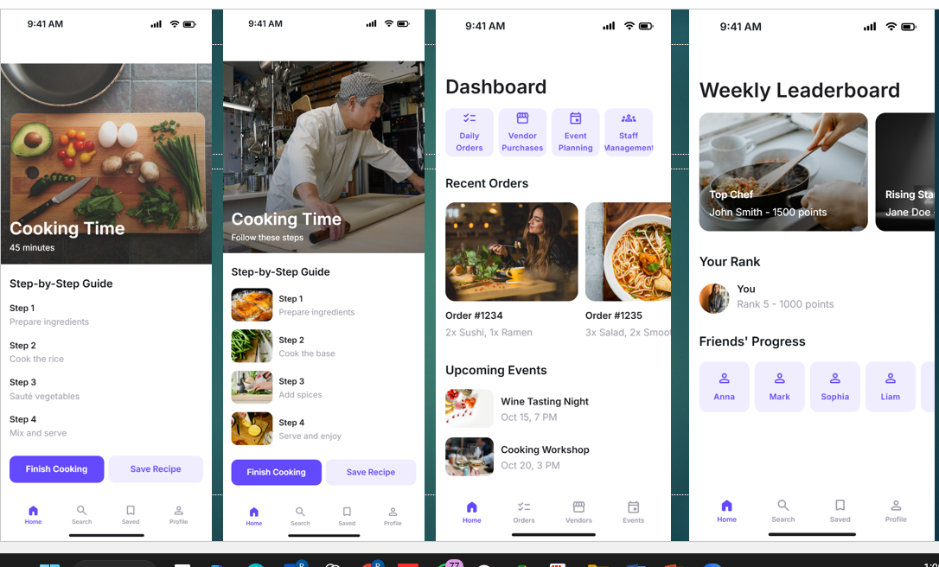

Slide 11
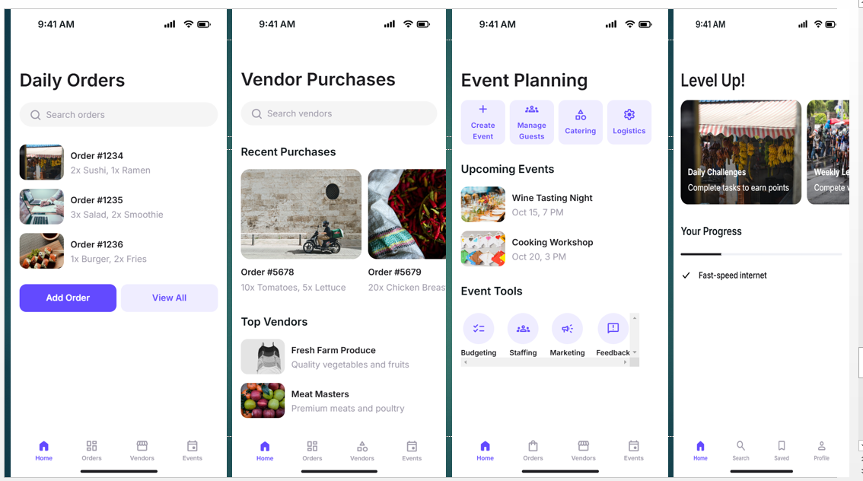

Slide 12

Challenges Faced
Recipe diversity: no legible curated dataset
Got Less time to get more data about everything
Error 429 Quotes : When API calling goes beyond limit to call API key

Slide 13
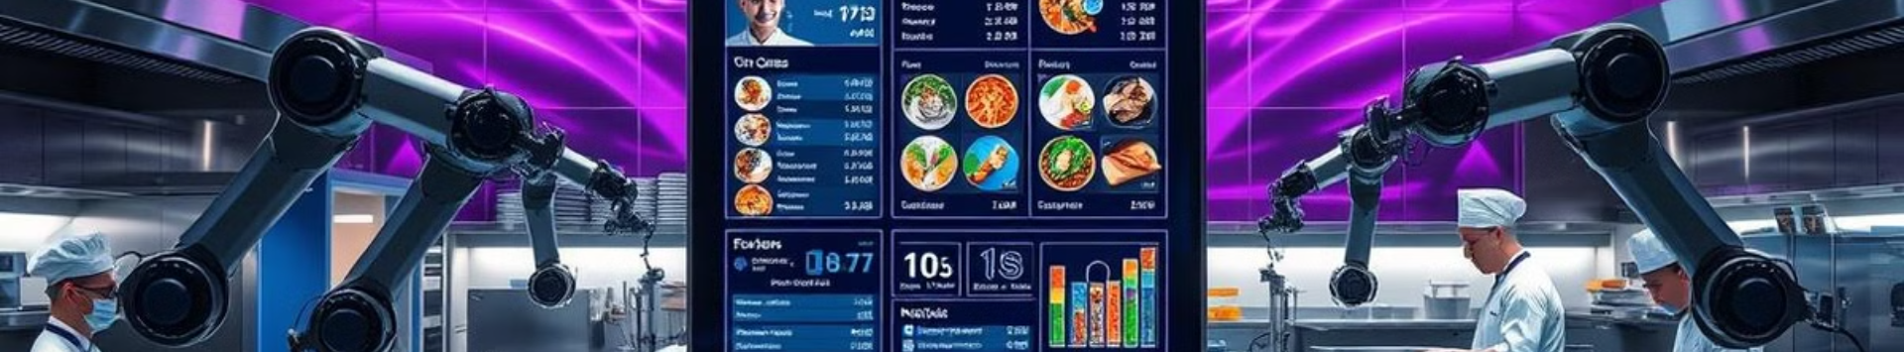
Conclusion
FutureEats revolutionizes restaurant management through AI. Enhanced efficiency, reduced waste, and elevated user engagement. Blending culinary creativity with AI, we're reshaping the dining experience.

